Slide 1

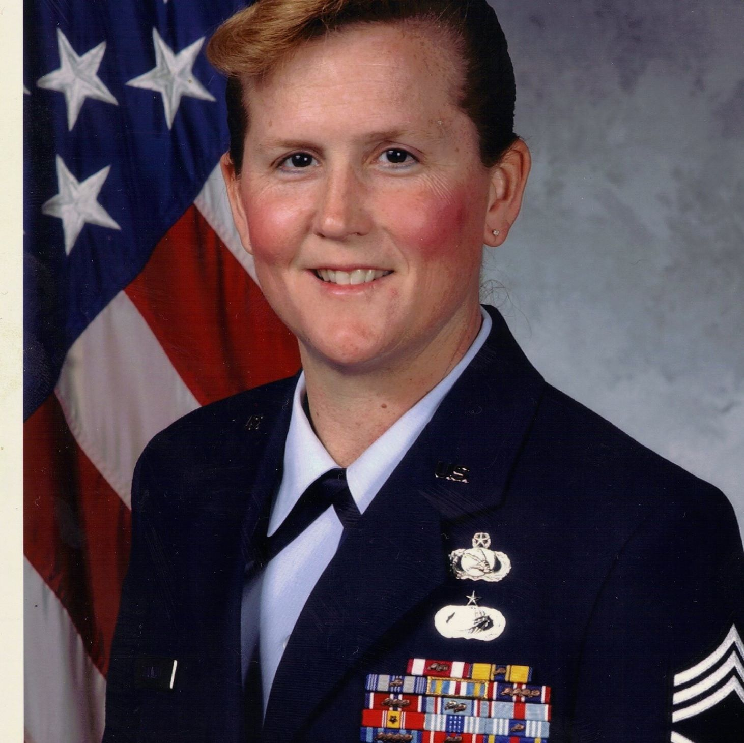

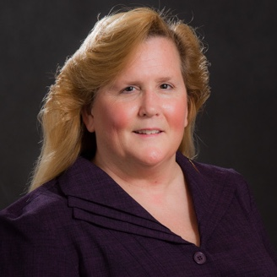
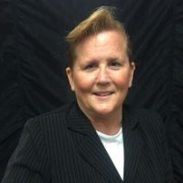
Women
Stephanie Harwell
Chief Master Sergeant (Ret.)
To change pictures:
Save the picture of the person you wish to use.
Single-left-click the grouped picture/shapes you wish to change on the poster. Single-left-click again on the picture.
Now single-right-click the picture and select “Change Picture” from the menu.
Choose the picture file you saved.
You may wish to single-left-click the grouped picture/shapes and single-left-click the new picture again to adjust its size or crop it—especially useful if the new picture is not the same aspect ratio as the previous one.
DO NOT CHANGE ROSIE THE RIVETER PICTURE!!!
In Technology
2004 Retired USAF Chief Master Sergeant
2007 Vice President of North America Defense Security & Systems Solutions, Inc.
2015 Chief Operations Officer of Metova CyberCENTS
Pioneer in the concept of cyber simulators for the USAF’s Cyber Operations Crew Force immersive training and exercising. Chief Harwell holds a patent for her work on simulated network environments.
“By using the range, we segregate play from the operational environment, reducing the risk of spillage. The use of the Virtual Private Network does not allow any of the aggressive actions to bleed over into normal day-to-day ops,” said Chief Master Sgt. Stephanie D. Harwell, AFCA network strategies and tactics superintendent.
What paths will you trailblaze that no one has traveled before?

